Slide 1

Yelp Business Rating Prediction using Tensorflow
Jarod Castillo
Intelligent Systems
9/30/2022

Slide 2
Model/code design (1 minute)
Stage 1: Preprocessing
Stage 2: Tensorflow Training
Stage 3: Predicting on a test set
Stage 4: Training for best model
Stage 5: Predicting with best model

Slide 3
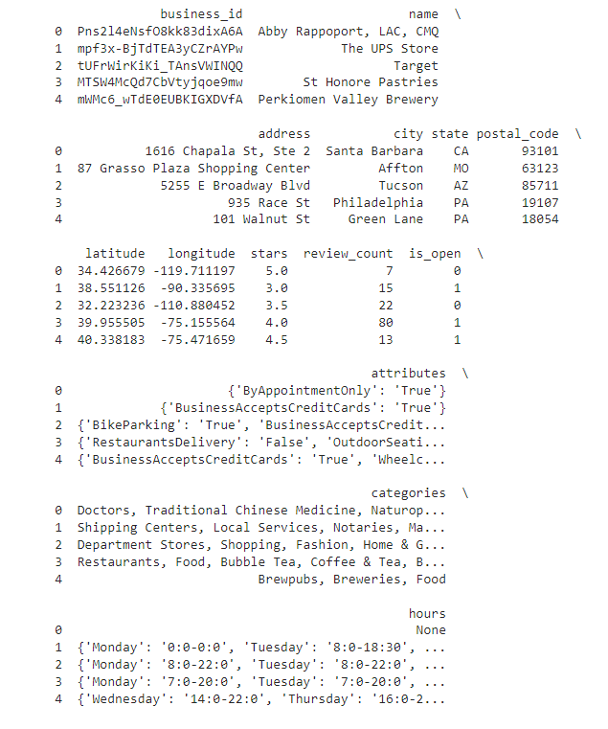
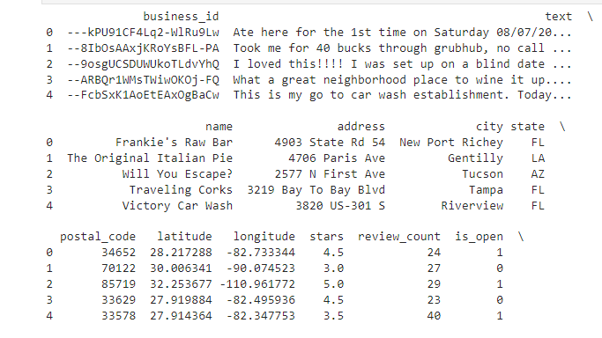
Stage 1: Preprocessing
Importing business data into a dataframe
Cleaning/filtering the data (take out businesses with < 20 reviews
Filtering review count

Slide 4
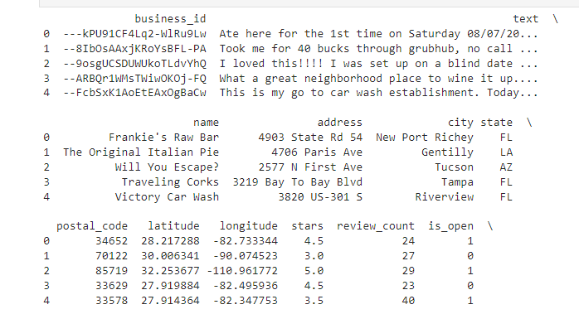
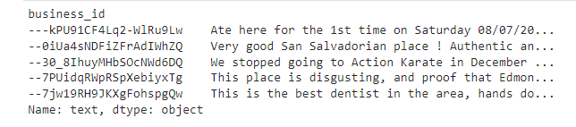
Stage 1: Preprocessing... continued
Loading review data into a dataframe and aggregate all review text to a single column.
Using a merge with inner-join to make a business data frame with all reviews aggregated.
Merge inner join

Slide 5
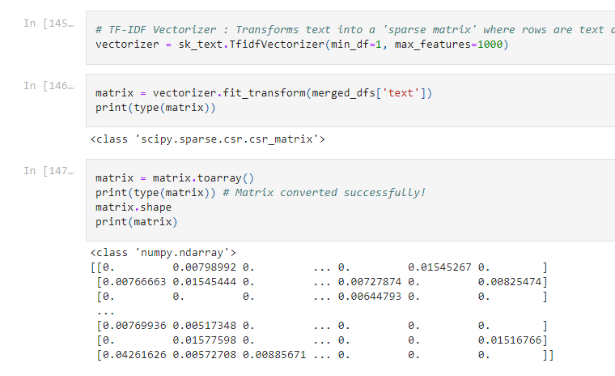
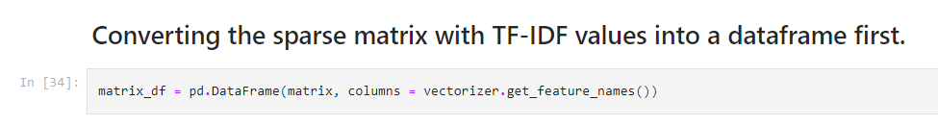
Stage 1: Preprocessing... continued
TF-IDF vectorizer used to create a matrix for 'text'.
Then converting that into a dataframe that can be used for merging into our final dataframe!
From matrix to dataframe

Slide 6
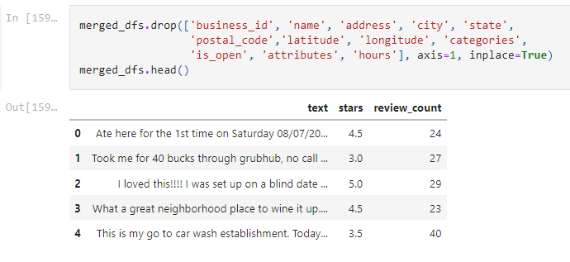
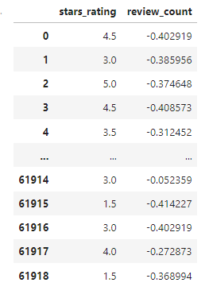
Stage 1: Preprocessing... continued
Dropping columns that I don't need.
Renaming stars column.
Encoding the review_count column.
Dropping the text column.

Slide 7
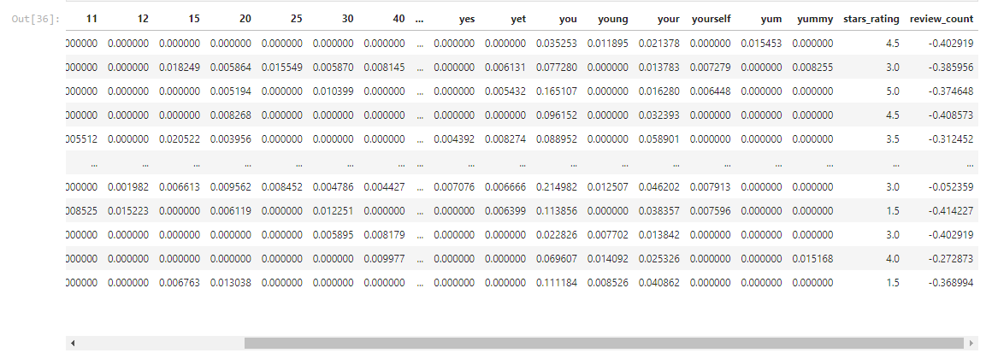
Stage 1: Preprocessing... continued
Final data frame consists of this now.

Slide 8
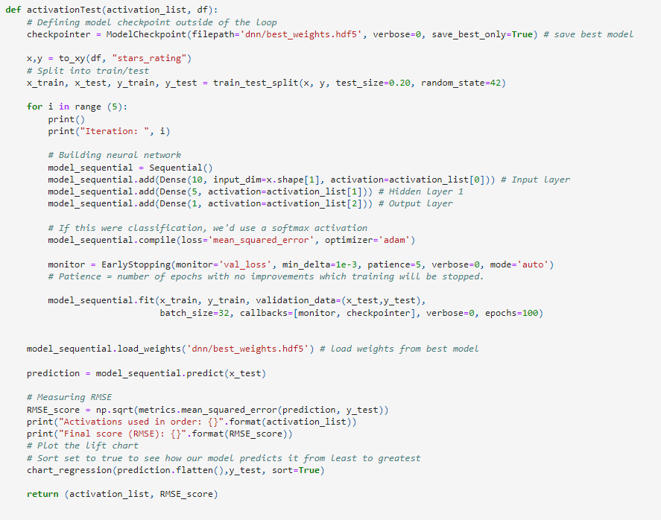
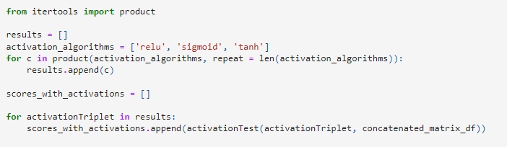
Stage 2: Tensorflow - Activation Function Test
Testing all permutations of relu, tanh and sigmoid. That's 27 iterations!
This took a while. I will show results in the results and analysis section.
Running tests

Slide 9
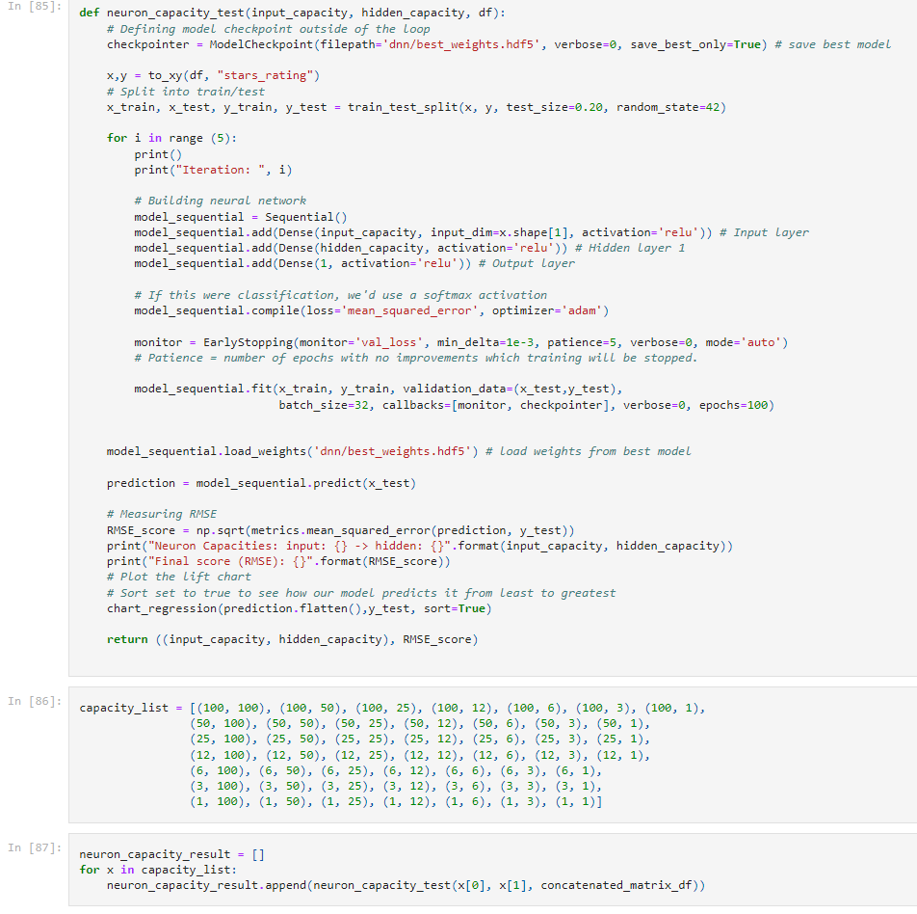
Stage 2: Tensorflow - Neuron count test
We are testing neuron capacity for each layer.
49 Possible combinations.

Slide 10
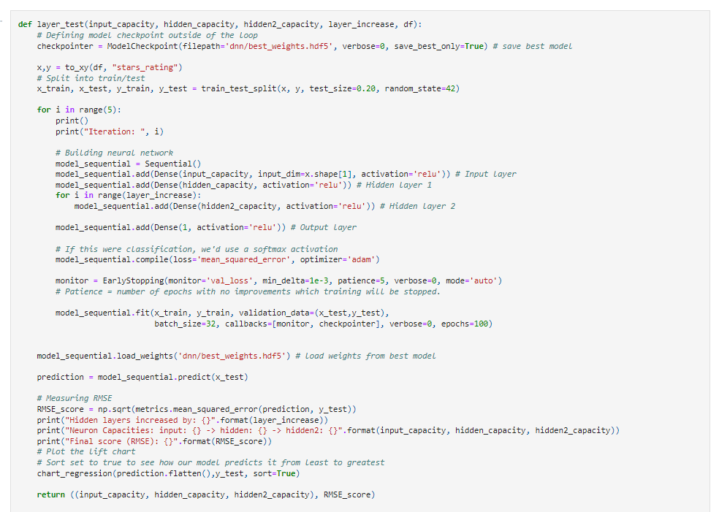
Stage 2: Tensorflow - Layer Test
Additional hidden layer testing
Increasing the number of layers per test

Slide 11
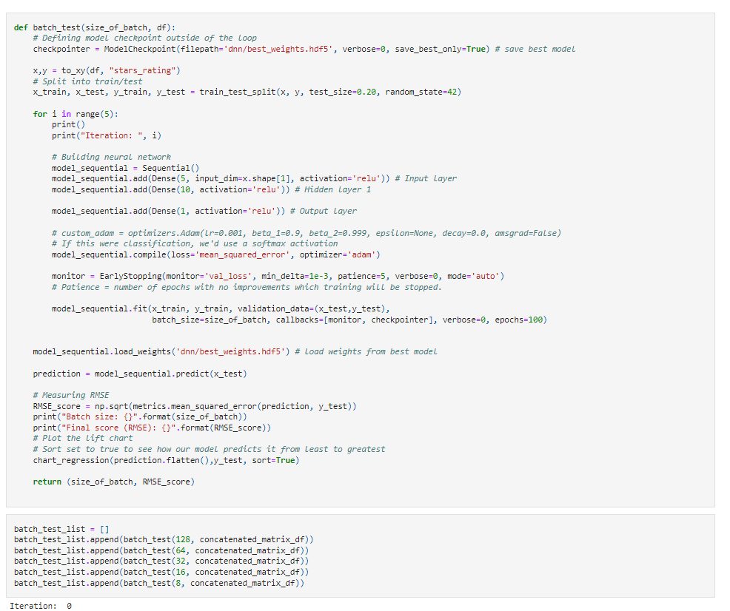
Stage 2: Tensorflow - Batch Test
Testing different batch sizes of: 128, 64, 32, 16, 8

Slide 12
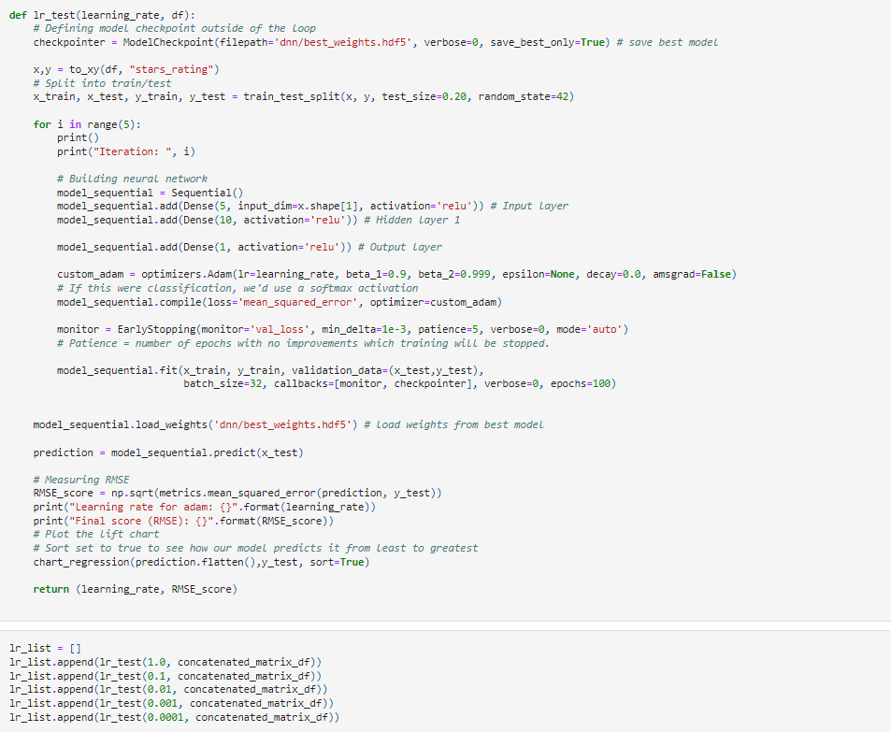
Stage 2: Tensorflow - Learning rate with Adam
Testing learning rate with Adam optimizer.

Slide 13
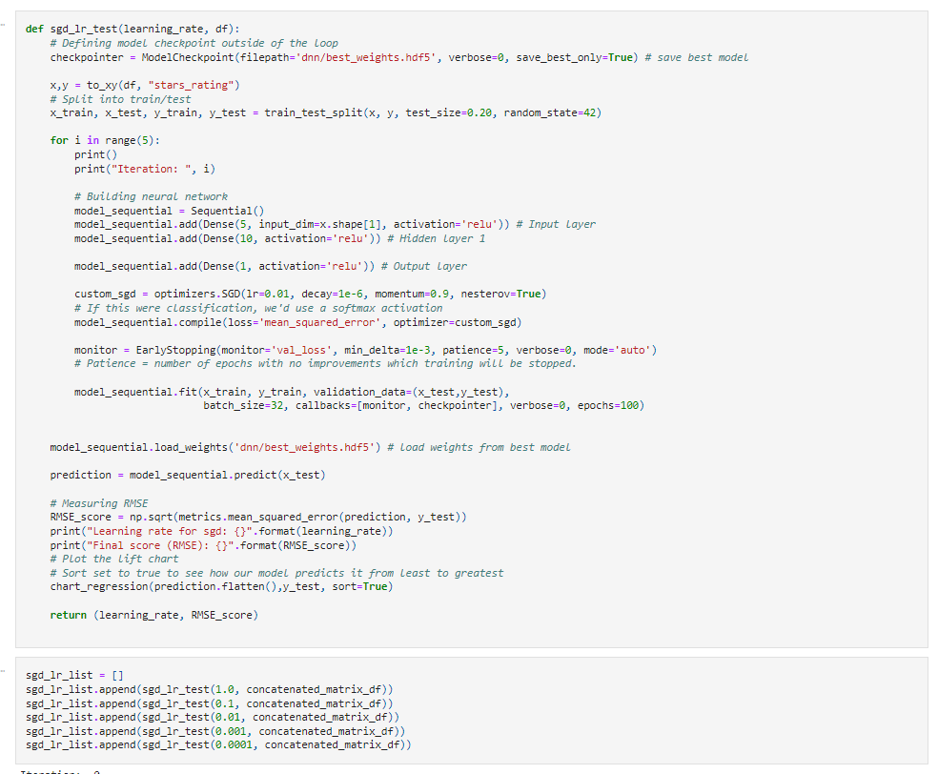
Stage 2: Tensorflow - Learning rate with SGD
Testing learning rate with SGD optimizer.

Slide 14
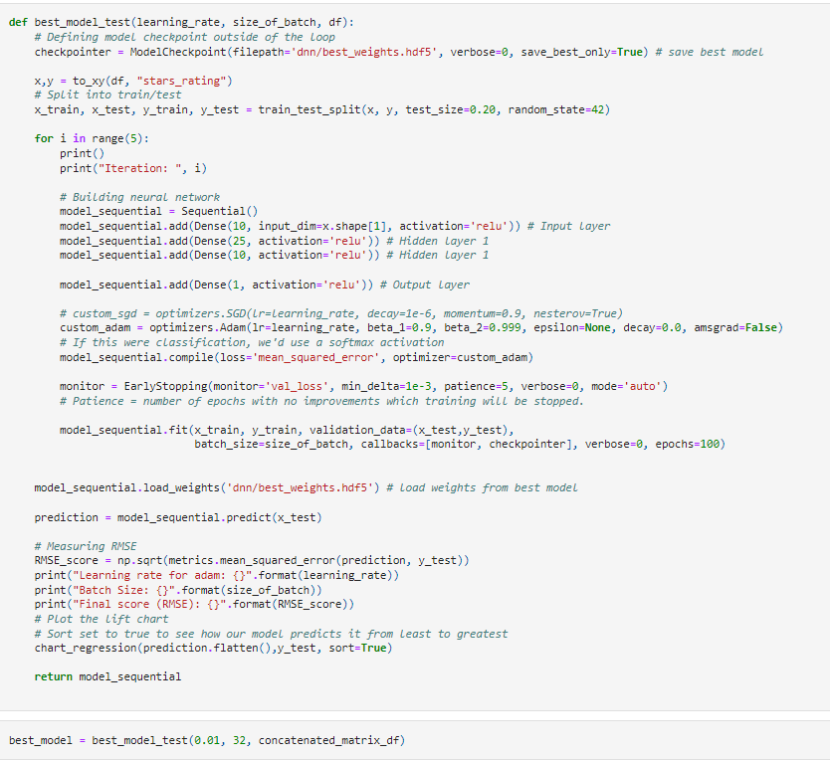
Stage 3: Saving the best model
I've also used that best model and produced a RMSE score for the the split/training session.

Slide 15
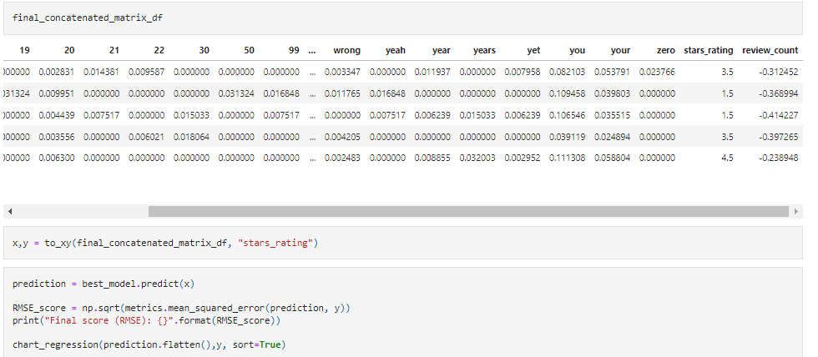
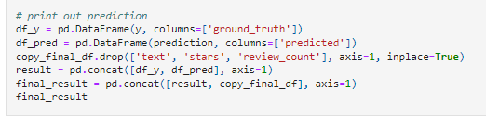
Stage 4: Doing predictions on test data
Using my best model...
I put the 5 businesses into a separate merged data frame for testing.

Slide 16
Findings/results (1 minute)
Activation Test Results
Neuron Capacity Test Results
Hidden Layers Count Test Results
Batch Size Test Results
Learning rates with different optimizers results
Best model results

Slide 17
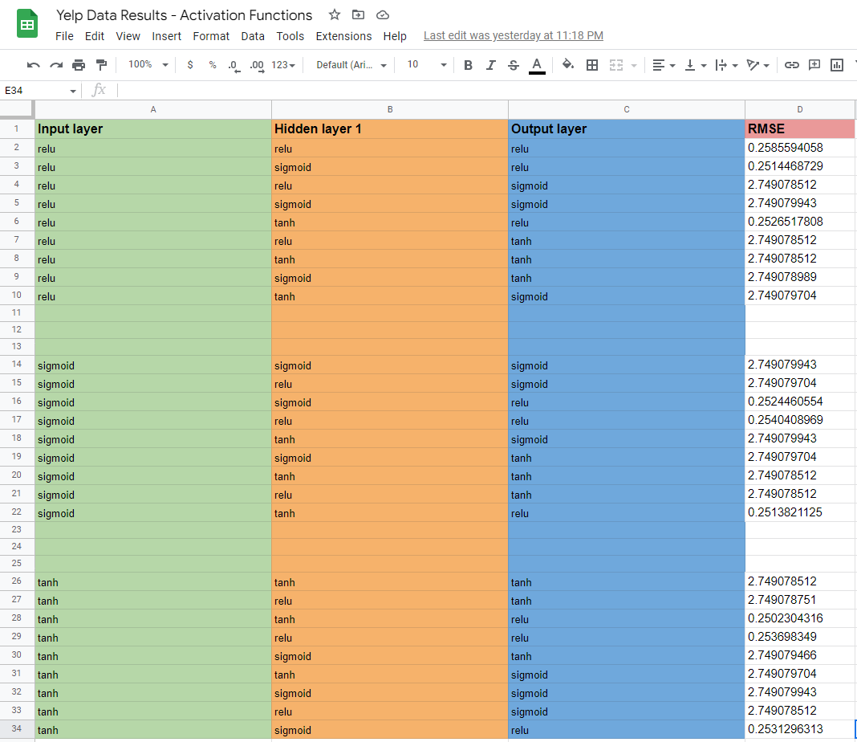
Activation Function Test Results
Output layer with RELU on regression problems lead to way better results.

Slide 18
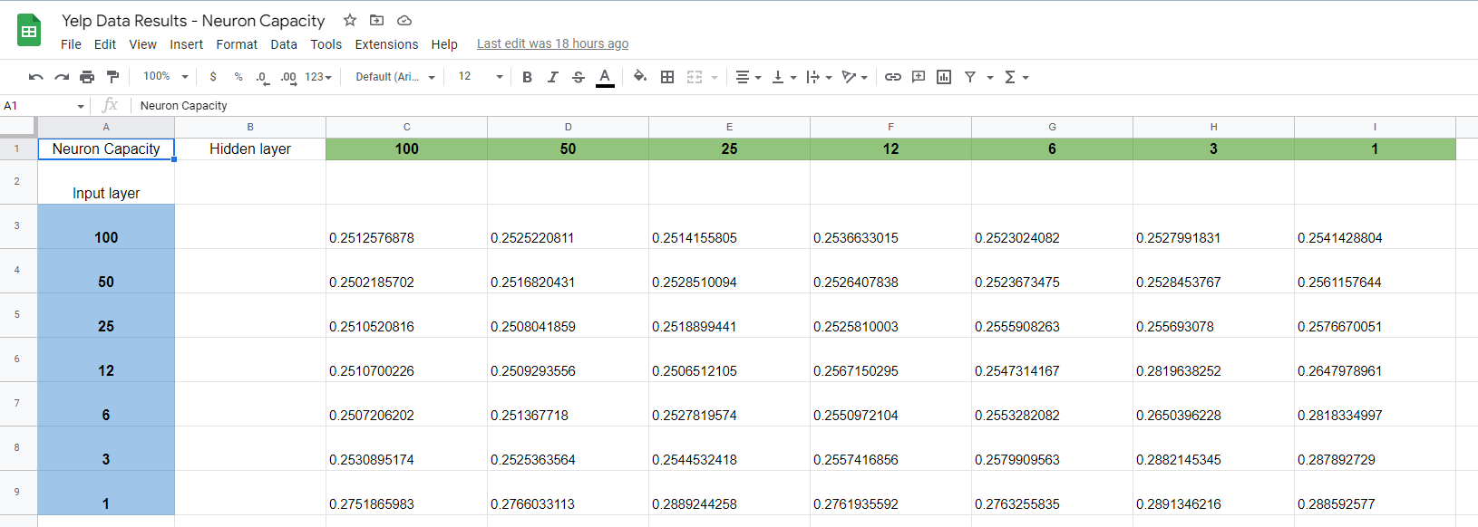
Neuron Capacity Test Results
Huge difference with very little neurons, not a whole lot with more.

Slide 19
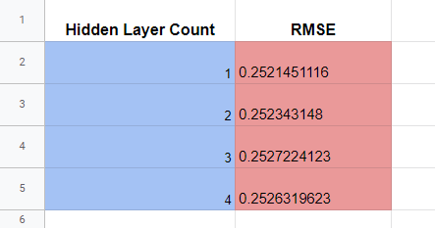
Hidden Layers Count Test Results
I don't see a huge difference.

Slide 20
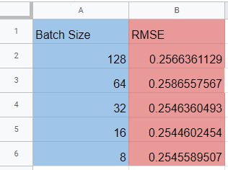
Batch Size Test Results
I'm seeing a slight difference between 64 and 32.

Slide 21
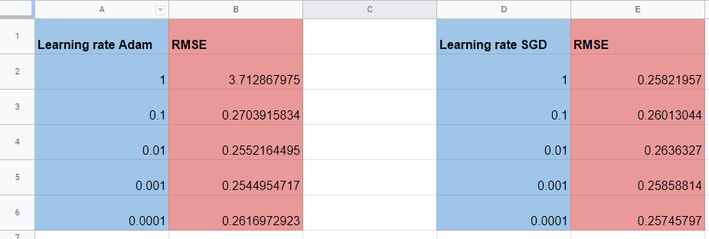
Learning Rates With Different Optimizers Results
Only difference I see is with a learning rate of 1.

Slide 22
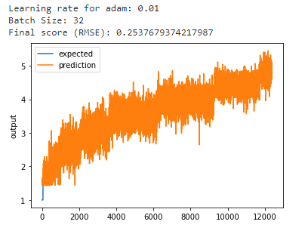
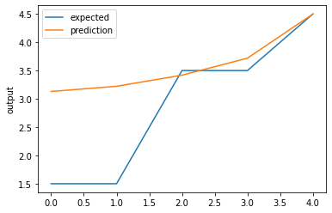
Best Model Results
Overall best results
5 Business Test
Final score (RMSE): 1.0655672550201416

Slide 23
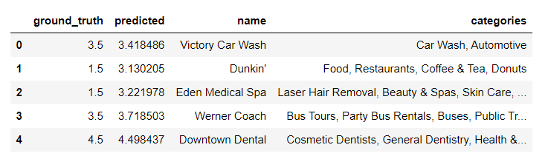
Best Model Results...continued

Slide 24
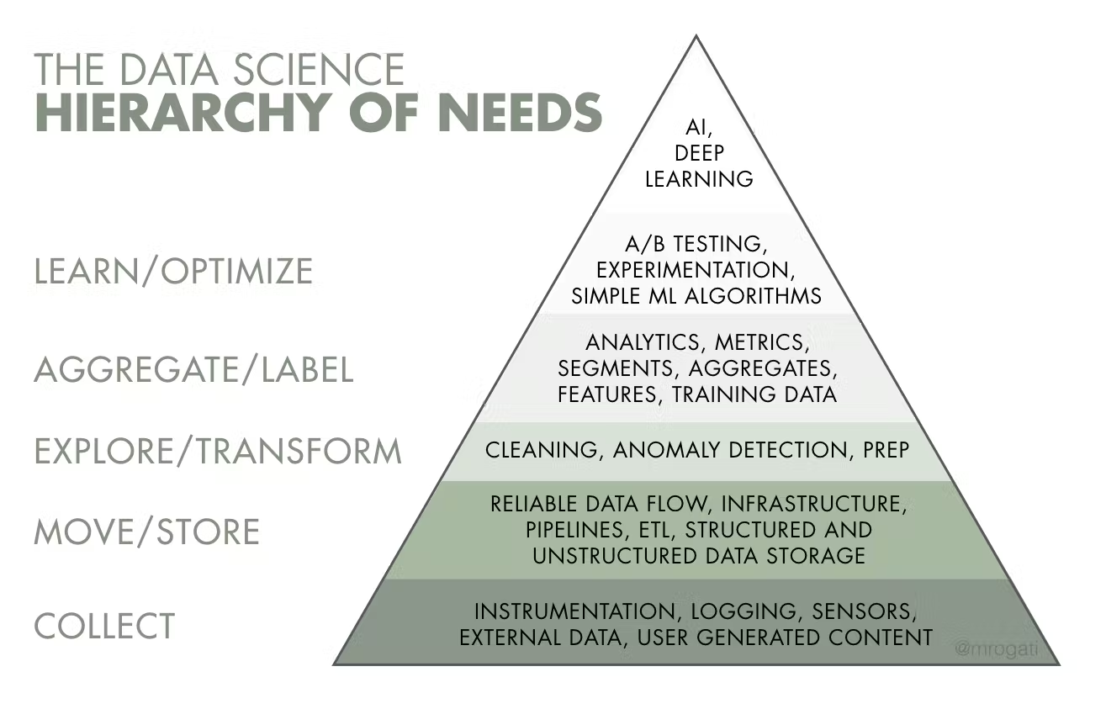
Task division, challenges encountered, and what you learned from the project (1 minute)
I did everything :)
Challenges were every single part of this project.
Explain where on the data hierarchy I could've improved.

